Slide 1
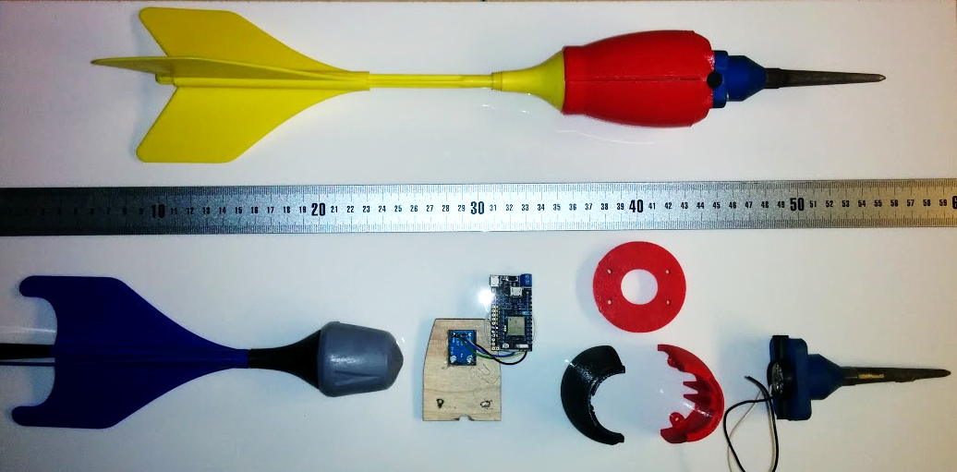
Wi-Fi enabled Micro-controller + accelerometer
3D printed outer casing
Geophones
(sensors)
Lawn Jarts (toy)

